Slide 1
Full Stack Keeper App - COMS W3102 Final Project
Rishabh Ganesh
Professor Ahmed
Full Stack Development
Spring 2024

Slide 2
Github Repository
https://github.com/rishabhg19/FullStackFinal

Slide 3
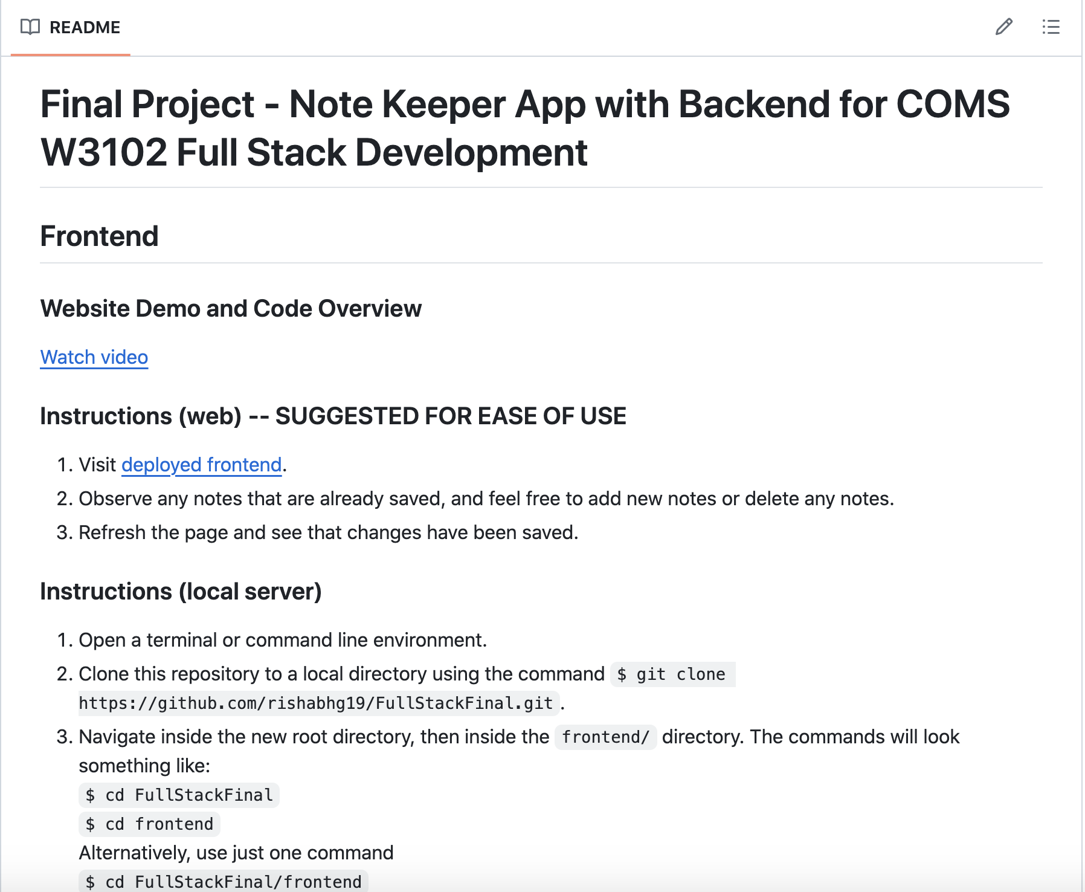
2. Preview of README file
README contains instructions, examples, images, and links guiding users on how to use the application on the web, and through running it on a local server

Slide 4
3. Deployed application
Frontend
https://full-stack-final-gilt.vercel.app/
The frontend of the application is deployed using Vercel. It may take some time to load the notes that are saved initially. It is designed to closely resemble the midterm user interface.
Backend
https://keeperappbackend-itaz.onrender.com/notes
The backend of the application is deployed using render. It has functionality for handling GET, POST, and DELETE requests from the client.

Slide 5
4. Reference link
TA Shivam’s Tutorials
https://www.youtube.com/playlist?list=PLCKLPJHmXyU_VXHlXJNoiteyidITvZXMX

Slide 6
5. Modifications
Change UI to make the frontend appear the same as the midterm
Redefine Note component
Use styling from midterm
Remove manual definition of _id from the note schema in the server model
MongoDB can assign unique ObjectId values by default
Make port number into an environment variable for abstraction
Connect React application to backend deployed on the web so that the application requires a maximum of one port on a local server to run
Without backend deployment, running the app locally would require two ports to run

Slide 7
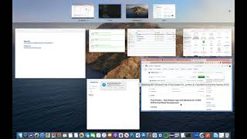
6. Video demo and code overview
https://www.youtube.com/watch?v=WG6nyjOz-_w

Slide 8
7. Things I’ve learned
Deployment
MongoDB
API Testing
Not all deployment tools are created equally; I tried Railway and Glitch, but Render worked best for me. There are many tools out there to accomplish the same goal, but some tools are more convenient than others.
During the lecture where we watched MongoDB setup tutorials, I created my first Atlas cluster. I did not know that I could use this same cluster for various collections of data for different projects. I had never used a NoSQL database prior to this project.
I did not realize the power of tools like Postman prior to this project. It is such a convenient way to debug an API. I used Postman to populate the notes server with jokes from the midterm.
Tailwind CSS
Environment Variables
Javascript Syntax
I learned how important it is to hide certain aspects of the application like the MongoDB URI using environment variables. WIthout this, I would publish my URI to github for anyone to use, which is a security risk.
I did not use Tailwind CSS in this project, but I learned how powerful it can be from tutorials, so I am sure it will come in handy in the future.
Javascript syntax is generally confusing to me, especially callback functions. From working on this project, I am more confident in my ability to effectively use callback functions in my applications.

